Slide 1
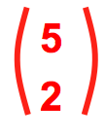
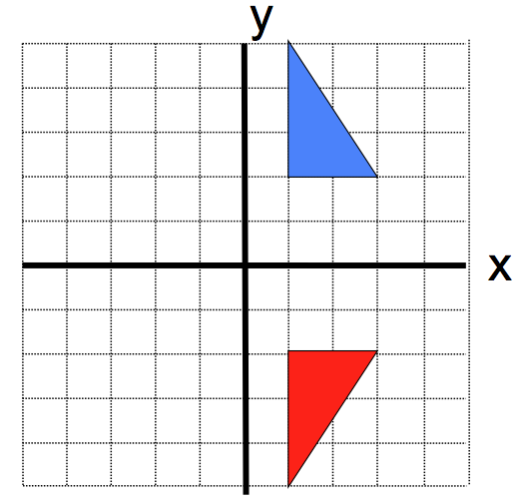
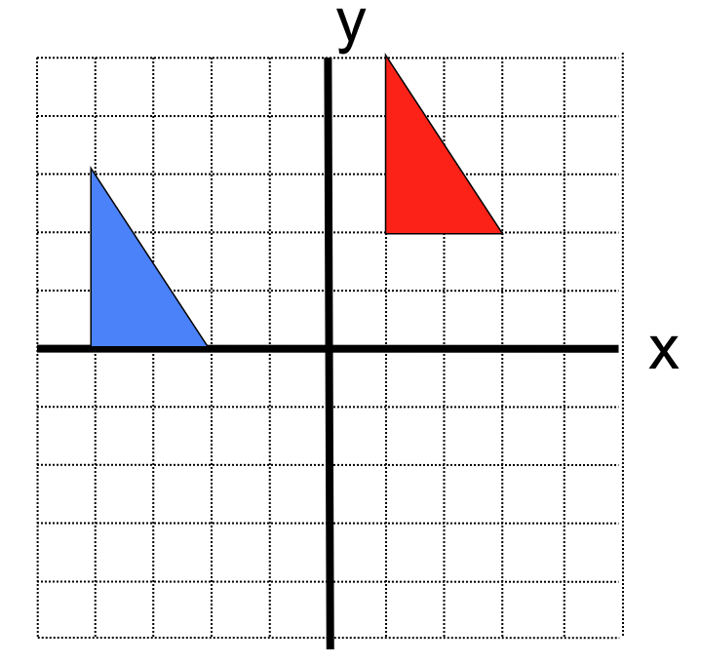
(1,0)
Mathematical
Treasure-hunt
y=0
Mathematical
Treasure-hunt
Previous Answer
Previous Answer
A translation has moved the blue square to the red square. Complete the vector for this translation
What is the line of reflection?
?
?
To the next clue
To the next clue
?
?
Card 9
Card 6

Slide 2
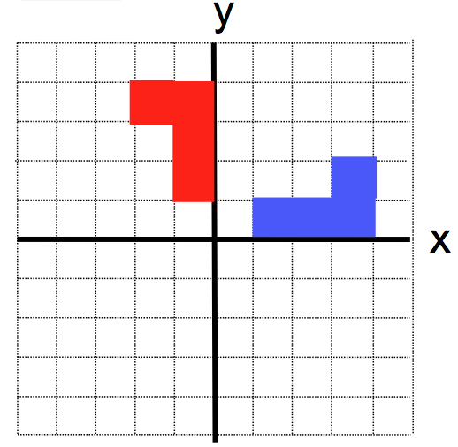
2
Mathematical
Treasure-hunt
90
Mathematical
Treasure-hunt
Previous Answer
Previous Answer
What is the angle of rotation if the blue shape has been rotated anticlockwise about (0,0)
What is the order of rotational symmetry of this shape?
?
To the next clue
To the next clue
?
Card 1
Card 5

Slide 3
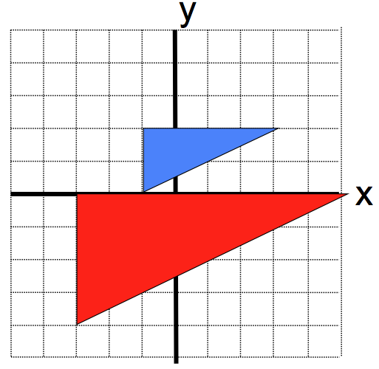
3
Mathematical
Treasure-hunt
6
Mathematical
Treasure-hunt
Previous Answer
Previous Answer
How many lines of symmetry does this shape have?
What is the centre of enlargement?
?
To the next clue
To the next clue
?
Card 10
Card 7

Slide 4
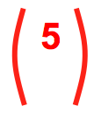
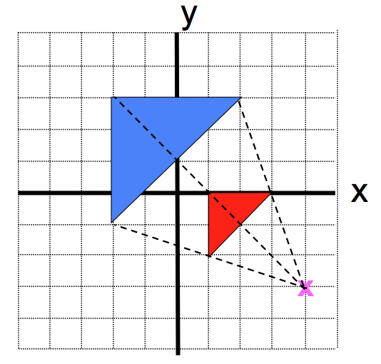
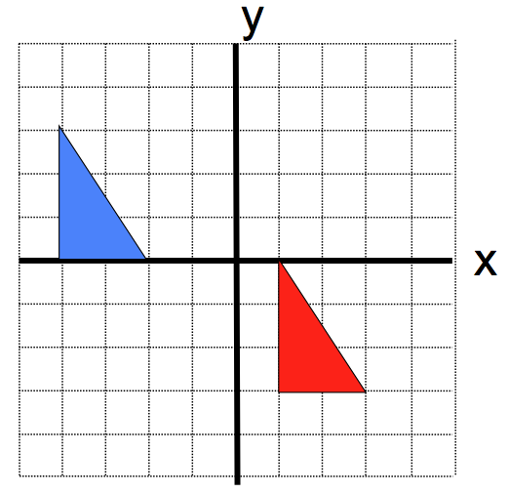
(1,4)
Mathematical
Treasure-hunt
-3
Mathematical
Treasure-hunt
Previous Answer
Previous Answer
A translation has moved the blue square to the red square. Complete the vector for this translation
What is the scale factor for the enlargement of the blue shape that creates the red shape?
?
To the next clue
To the next clue
?
Card 2
Card 8

Slide 5
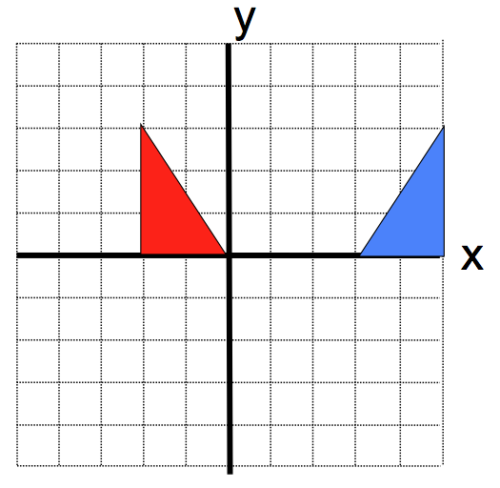
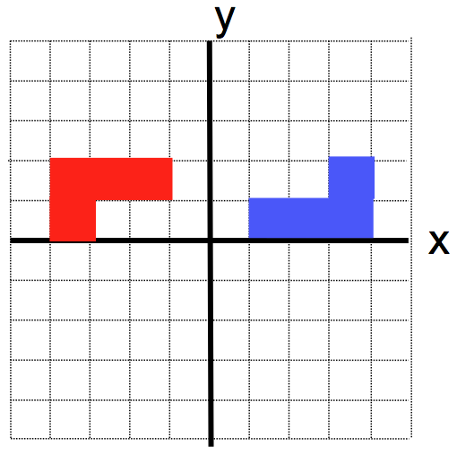
x=1.5
Mathematical
Treasure-hunt
0.5
Mathematical
Treasure-hunt
Previous Answer
Previous Answer
What is the centre of rotation when the blue shape is rotated by 180° to create the red shape?
What is the mirror line?
?
To the next clue
To the next clue
?
Card 3
Card 4

Slide 6
Answer Sheet
Answer Sheet
Team
Team
Time Taken
Time Taken

